Slide 1
INTRODUCTION
AUM SRI SAIRAM

Slide 2
General Flow
Understanding Data
Data Collection
Data Pre-Processing
Algorithms(DM techniques and ML Tasks)
Metrics for evaluation/Assessment
Bias-Variance Trade-off

Slide 3
Data Mining
Statistical Learning
Machine Learning
Databases
Data warehouses
DataMart
Distributed and Parallel Computing

Slide 4
Data Size and Usage
Statistics: Sample 30
ML:100-1000
DM: Peta(10^15) to Exa bytes(10^18)
Database: Data ware houses- Statistics-ML-DM-Big Data-DS
ML-Mathematical
DM-Applications

Slide 5
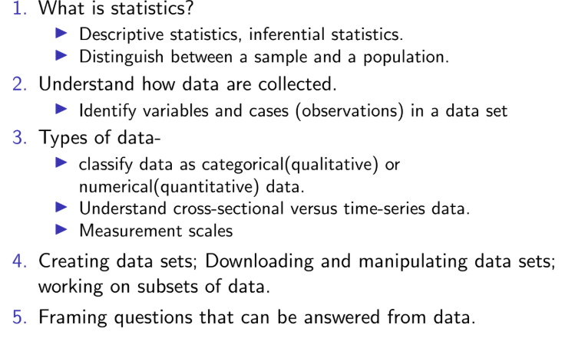

Slide 6
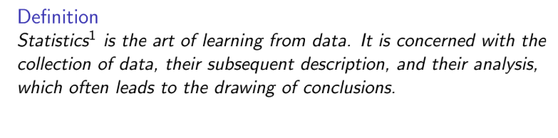

Slide 7
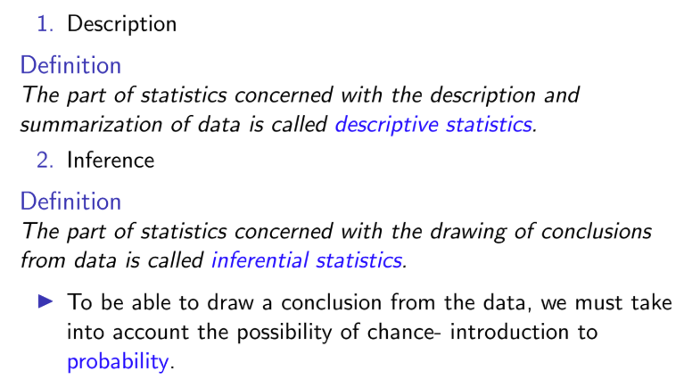

Slide 8
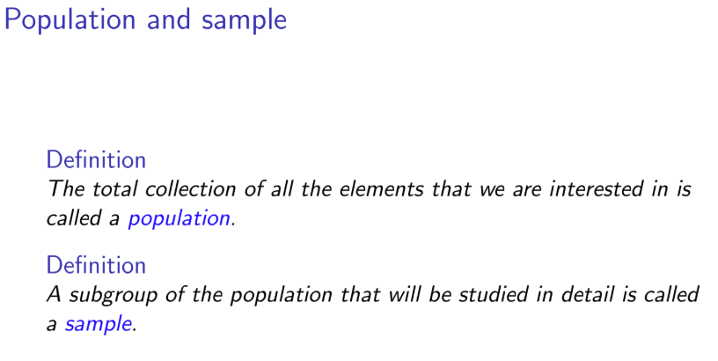

Slide 9
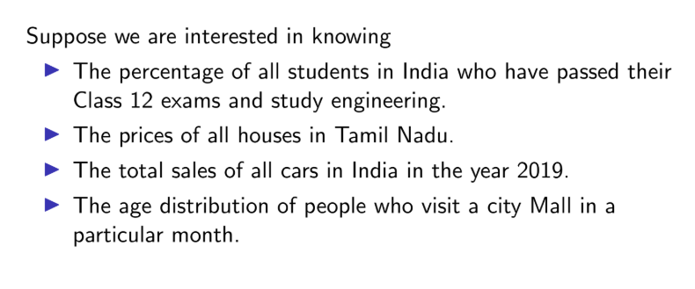

Slide 10
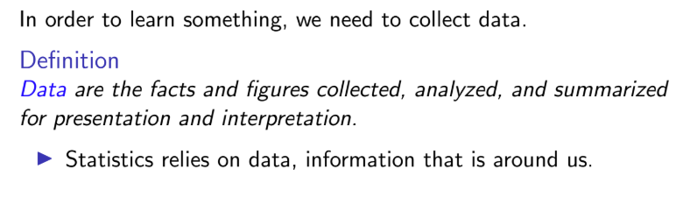

Slide 11
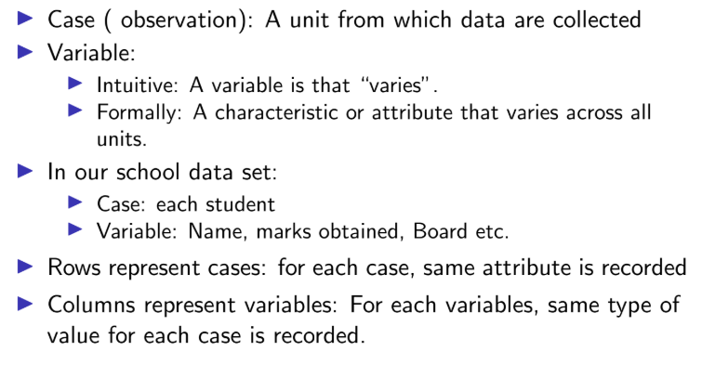
Variables and cases

Slide 12
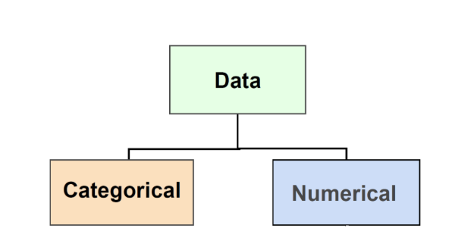

Slide 13
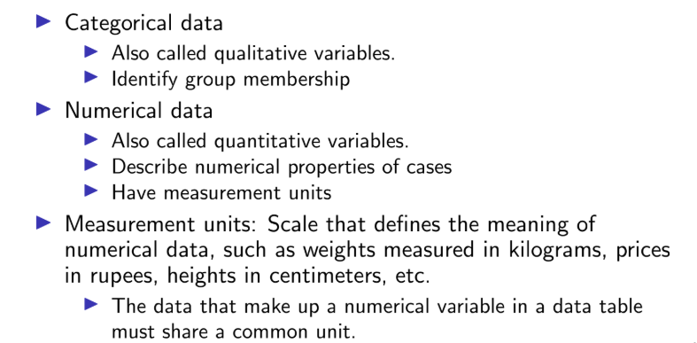

Slide 14
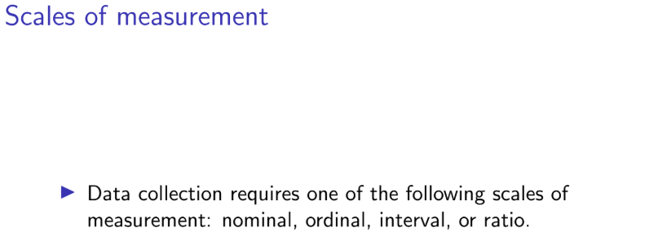

Slide 15
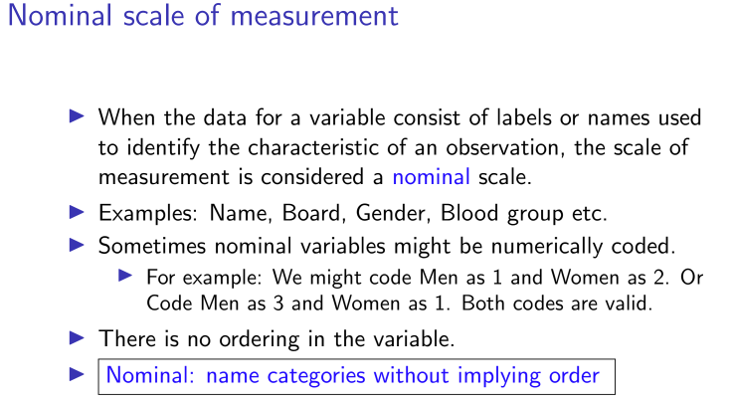

Slide 16
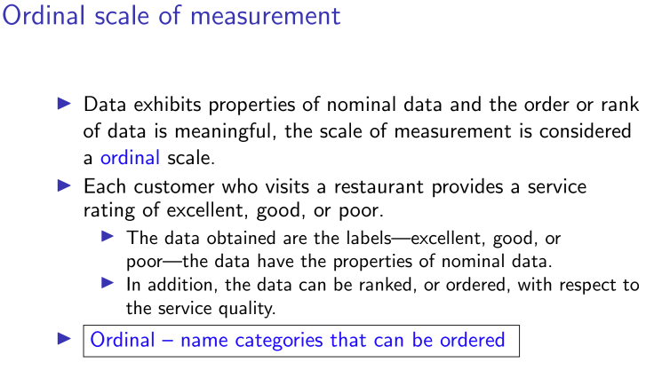

Slide 17
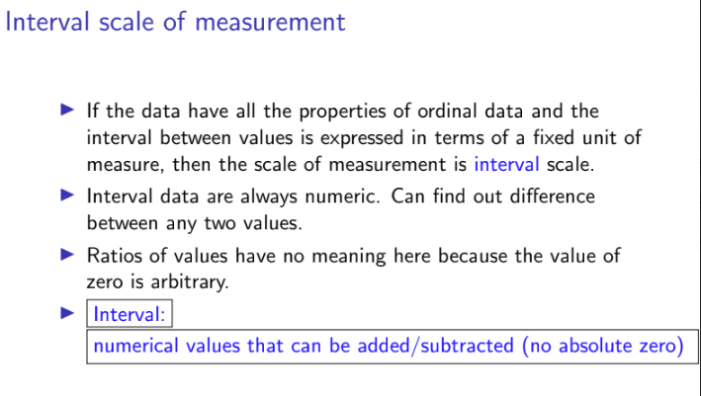

Slide 18
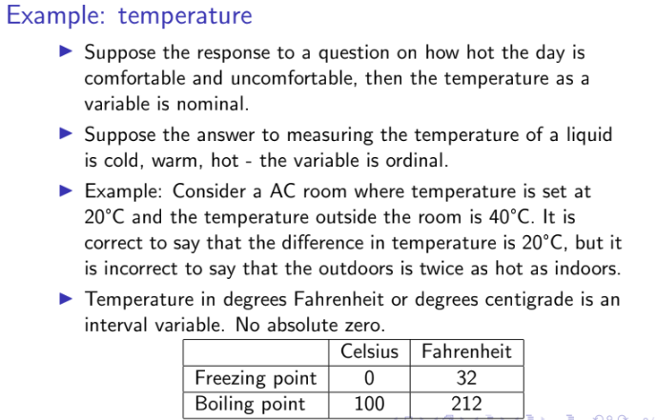

Slide 19
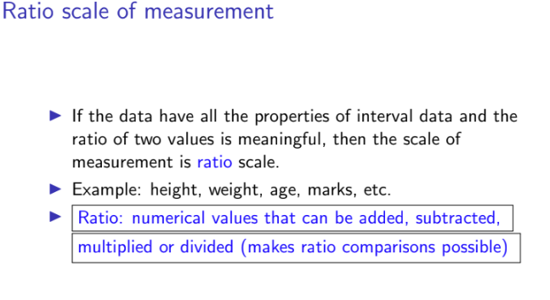

Slide 20
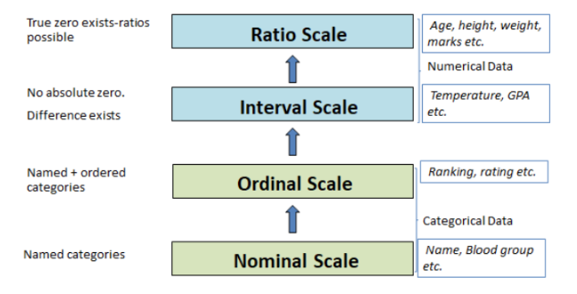

Slide 21
Data
Numbers
Video
Image
Text
Simulation
Audio
Graphs
Social Networks

Slide 22
Iris Data set
The Iris dataset is a classic and widely used in machine learning and statistics. It was introduced by British biologist and statistician Ronald A. Fisher in 1936.
The dataset consists of 150 samples of iris flowers from three species:
Iris setosa
Iris versicolor
Iris virginica
For each flower, four features (measurements in centimeters) are recorded:
Sepal length
Sepal width
Petal length
Petal width
The goal is often to build models that classify the species based on these features.

Slide 23
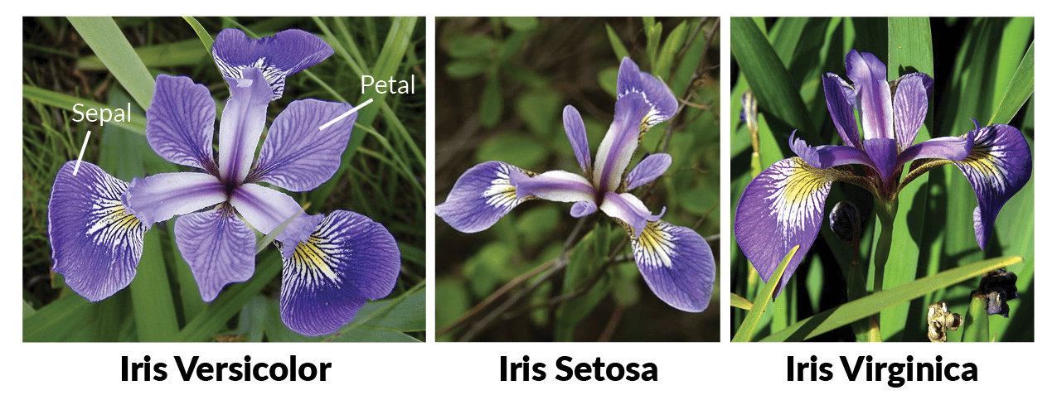

Slide 24
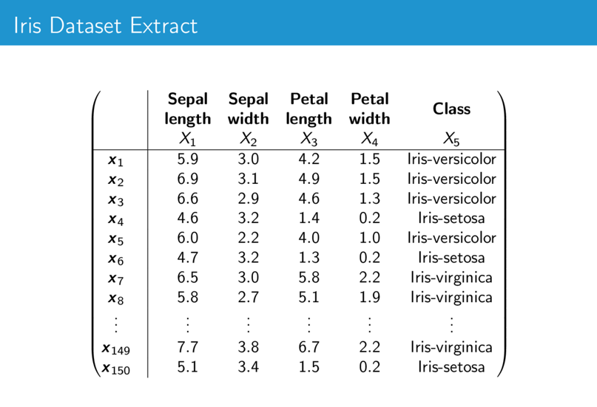

Slide 25
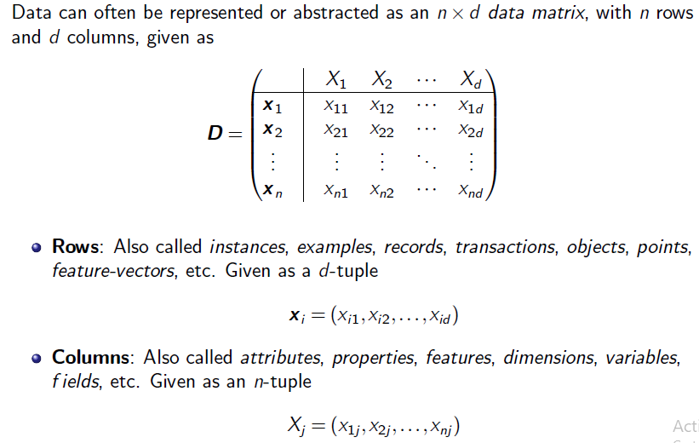
Data Matrix

Slide 26
Three Views
LA, P&S, and Calculus for understanding
Three views of the dataset: Algebraic view, Statistical View, and Geometric View
Statistics-100 Years
Yahoo Directory-Human Curators– Web Page Classification
Requirement: Early 1990’s: Computationally Fast
Volmert: Data warehouses- OLAP
Company: Business trends, Real-time
Store Organization-Consumer Behaviour Amazon…

Slide 27
Example
Task-1
Generate a Data matrix for the following:
The warden wants to analyze what types of items students frequently purchase from the hostel store to manage inventory better and identify demand patterns.
An institute wants to analyze the academic performance of students across multiple subjects.
Analyzing the sentiment of student reviews about hostel facilities.
Classifying cleanliness levels in hostel rooms from photos.
Analyzing complaints recorded via voice in the hostel.
Monitoring student participation in hostel events via video footage.
Forecasting daily food consumption in a hostel mess for 50 students over 7 days.

